Slide 1
PROJECT BOOKSTORE
Course: PQ-JDEV-B001
Member: Phan Hoàng Phước
Nguyễn Duy Hiếu
Nguyễn Thanh Nguyên Duy
Hoàng Thị Hoài Thương
…
Last updated: 15/8/2019

Slide 2
CONTENTS
1. OVERVIEW
1.1 DESCRIPTION
1.2 SUPPORTING TOOL
2. ARCHITECTURE OVERVIEW
2.1 SPRING MVC
2.2 OVERVIEW DATABASE
3. FUNCTION LIST
3.1 USER MANAGEMENT
3.2 PUBLISHINGHOUSE MANAGEMENT
3.3 CATEGORY MANAMENT
3.4 BOOK MANAGEMENT

Slide 3
1. OVERVIEW
1.1 DESCRIPTION
Develop book store system, allowing users to choose according to their preferences.
These are indispensable functions to optimize usage time as well as book management.

Slide 4
1. OVERVIEW
1.2 SUPPORTING TOOL
DEVELOPING SOFTWARE |  | Eclipse-Spring Tool Suite 4, Apache Tomcat 9, MySQL, GitHub, JDK 12.
FRONT - END LANGUAGE FRAMEWORK |  | HTML5, CSS3, JavaScript, JQuery, Bootstrap3, Thymeleaf.
BACK - END LANGUAGE FRAMEWORK |  | Java, spring ORM, spring AOP, spring MVC, spring CORE, Hibernate, Spring Data repository.

Slide 5
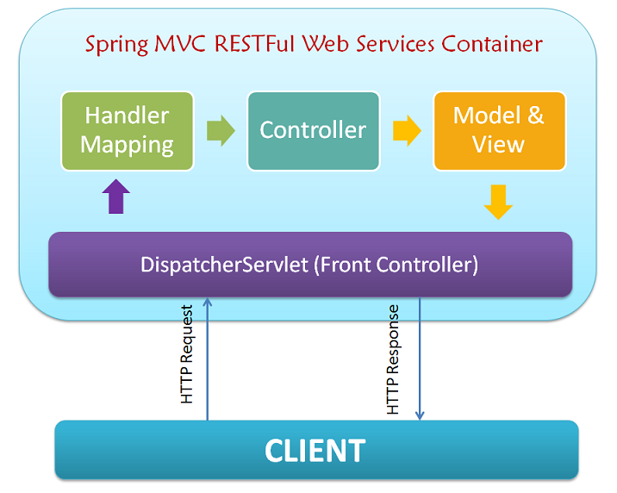
2. ARCHITECTURE OVERVIEW
2.1 SPRING MVC
MVC MODEL

Slide 6
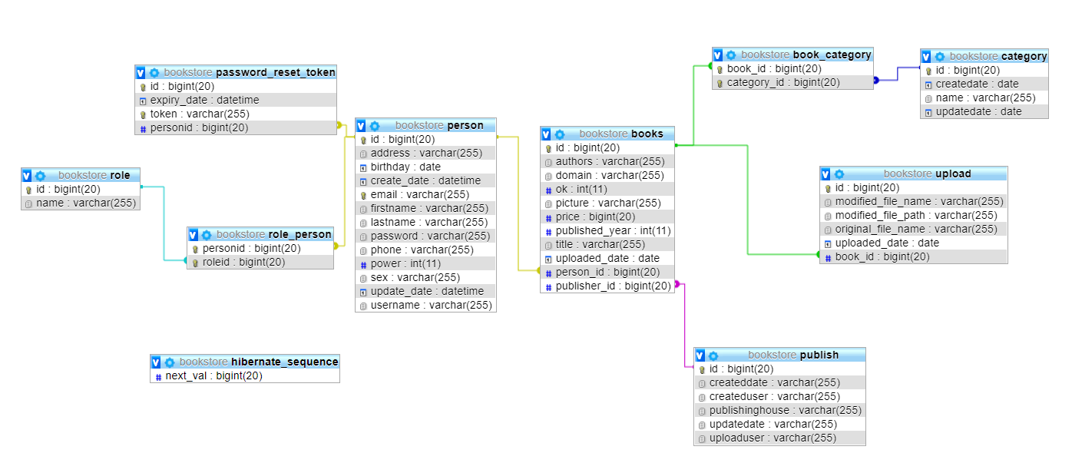

2. ARCHITECTURE OVERVIEW
3.1 OVERVIEW DATABASE
CONFIGURING THE DATABASE

Slide 7
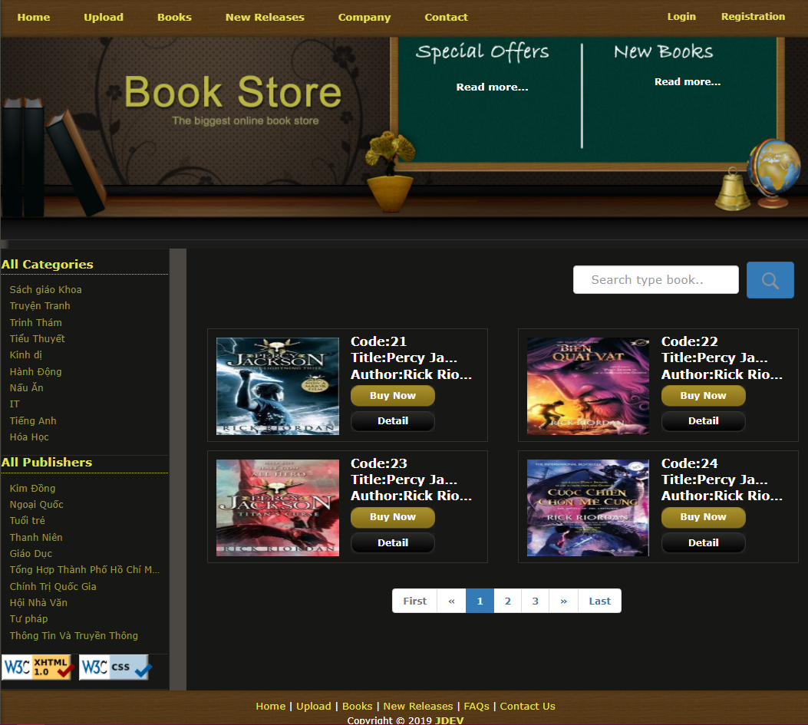
3. FUNCTION LIST
3.1 USER MANAGEMENT
INDEX

Slide 8
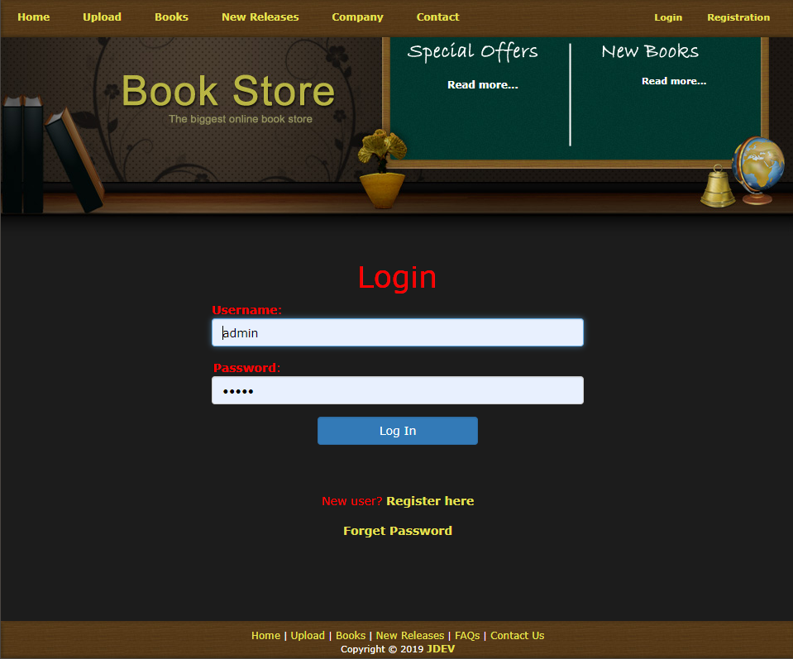
3. FUNCTION LIST
3.1 USER MANAGEMENT
LOGIN

Slide 9
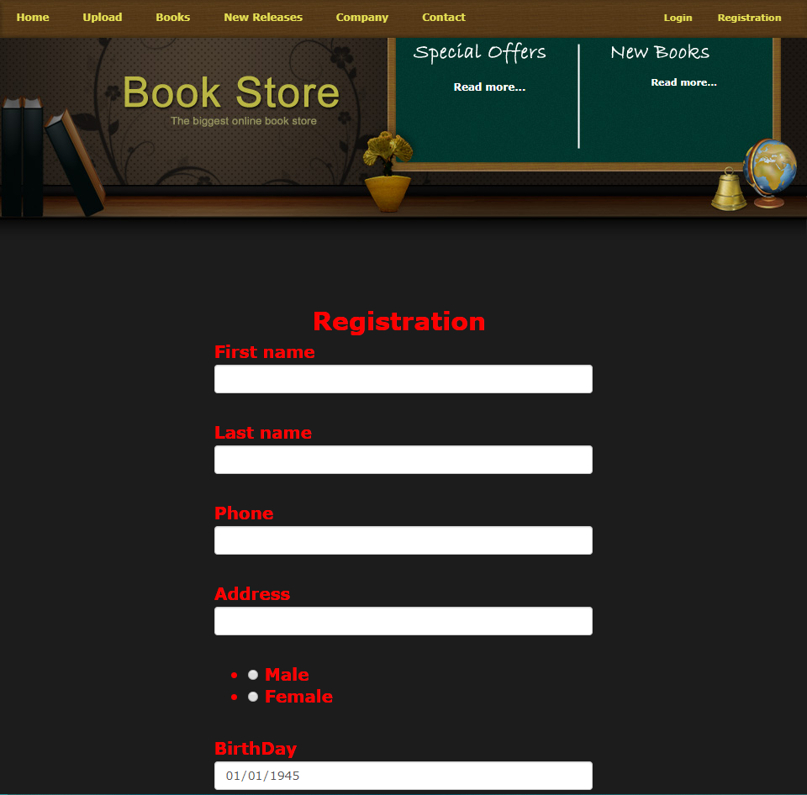
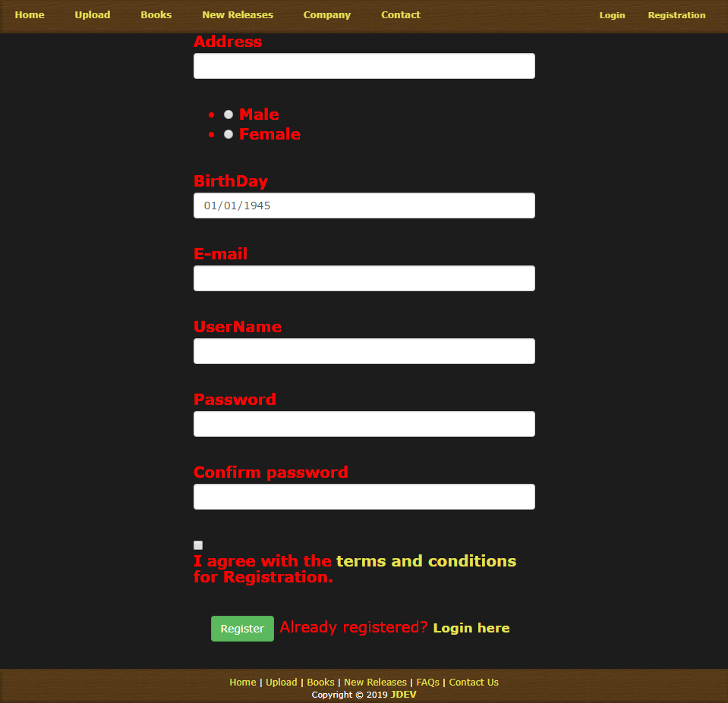
3. FUNCTION LIST
3.1 USER MANAGEMENT
REGISTRATION

Slide 10
3. FUNCTION LIST
3.1 USER MANAGEMENT
INDEX

Slide 11
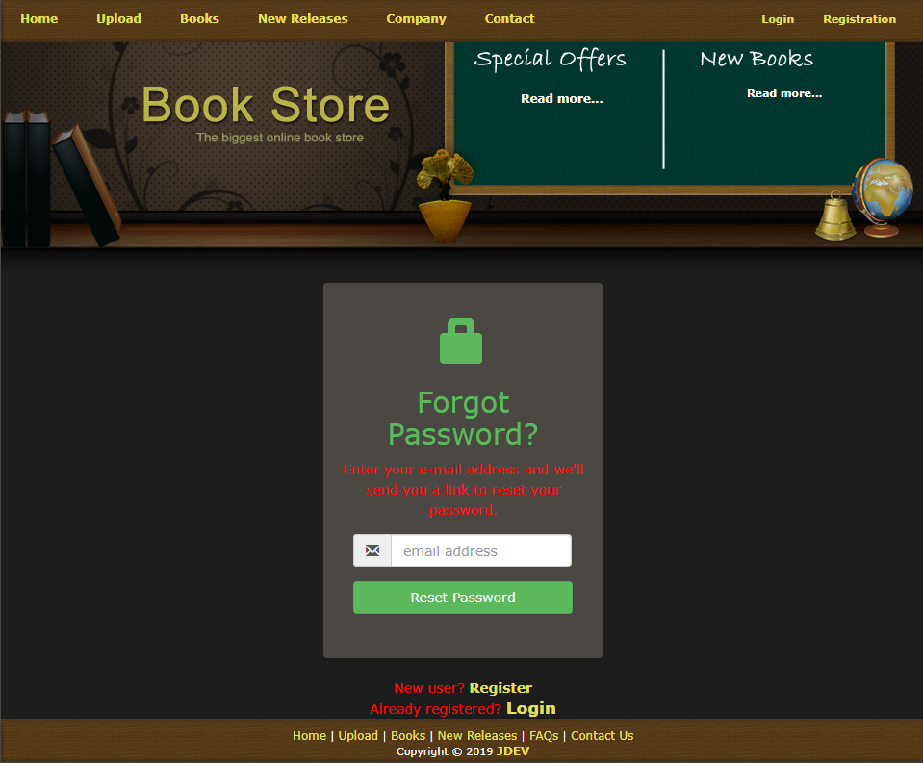
3. FUNCTION LIST
3.1 USER MANAGEMENT
FORGET PASSWORD

Slide 12
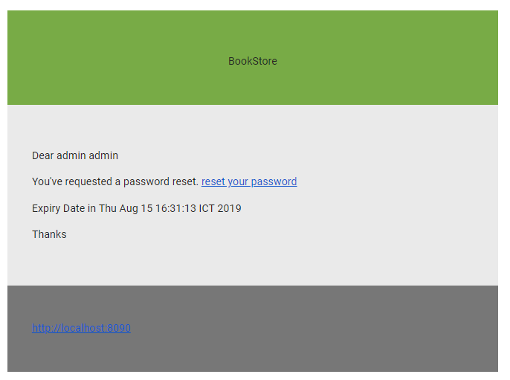
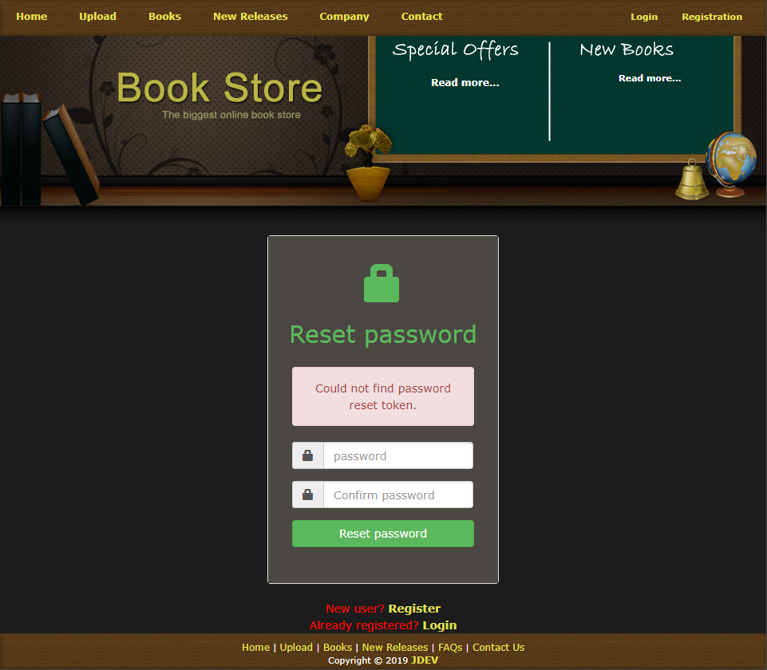

3. FUNCTION LIST
3.1 USER MANAGEMENT
CHECK MAIL
RESET PASSWORD

Slide 13
3. FUNCTION LIST
3.1 USER MANAGEMENT
INDEX

Slide 14
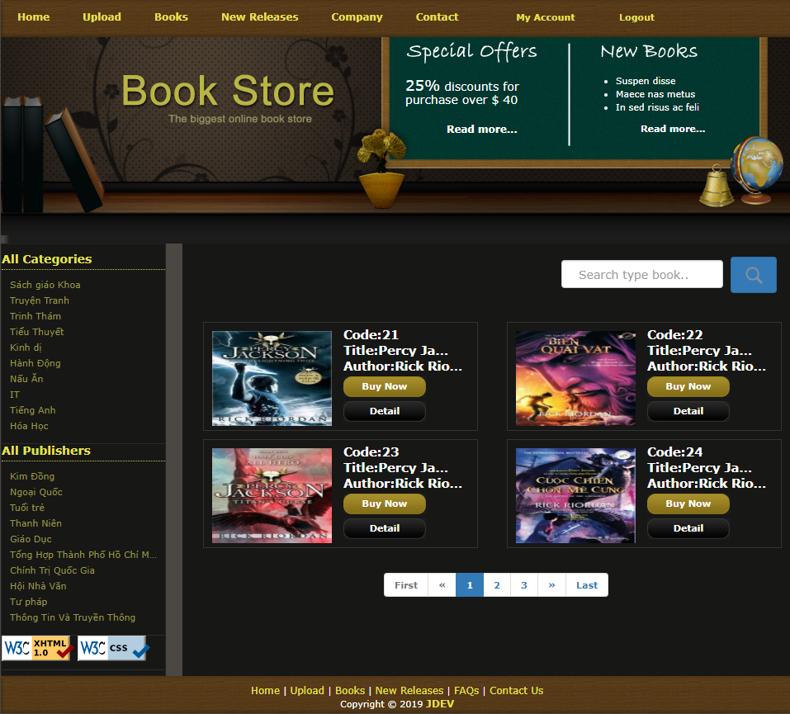

3. FUNCTION LIST
3.1 User management
INDEX USER
INDEX ADMIN

Slide 15
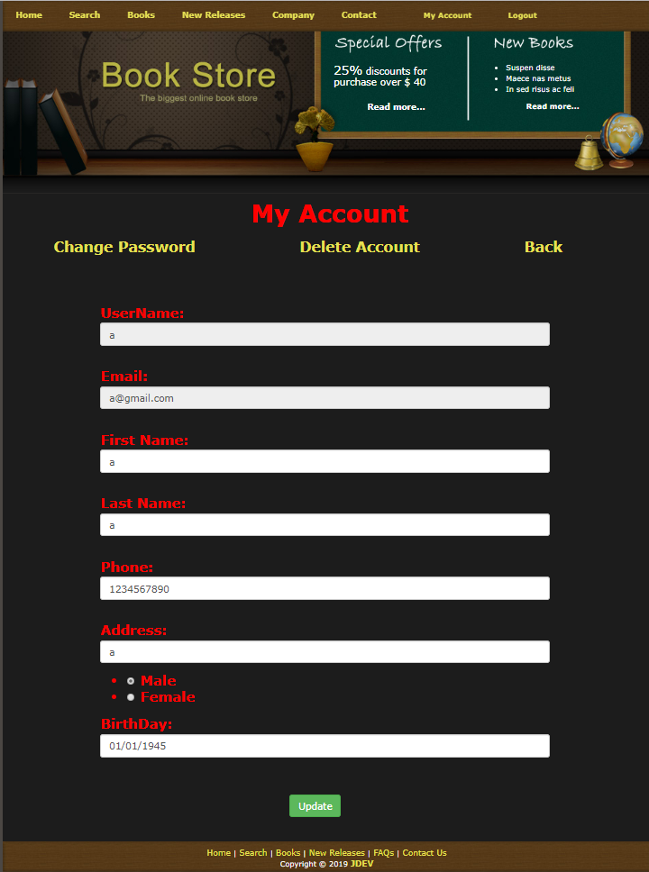
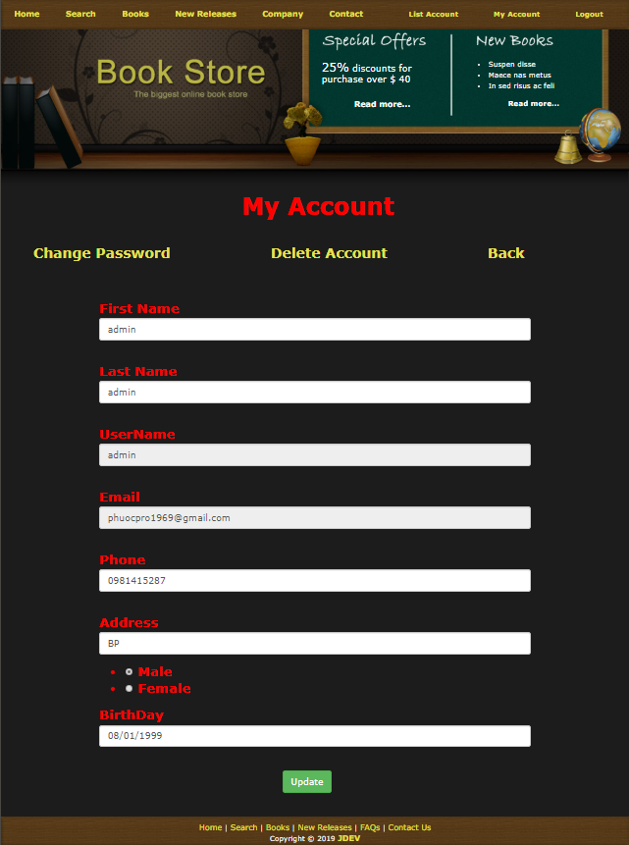
3. FUNCTION LIST
3.1 USER MANAGEMENT
INFOMATION USER
INFOMATION ADMIN

Slide 16
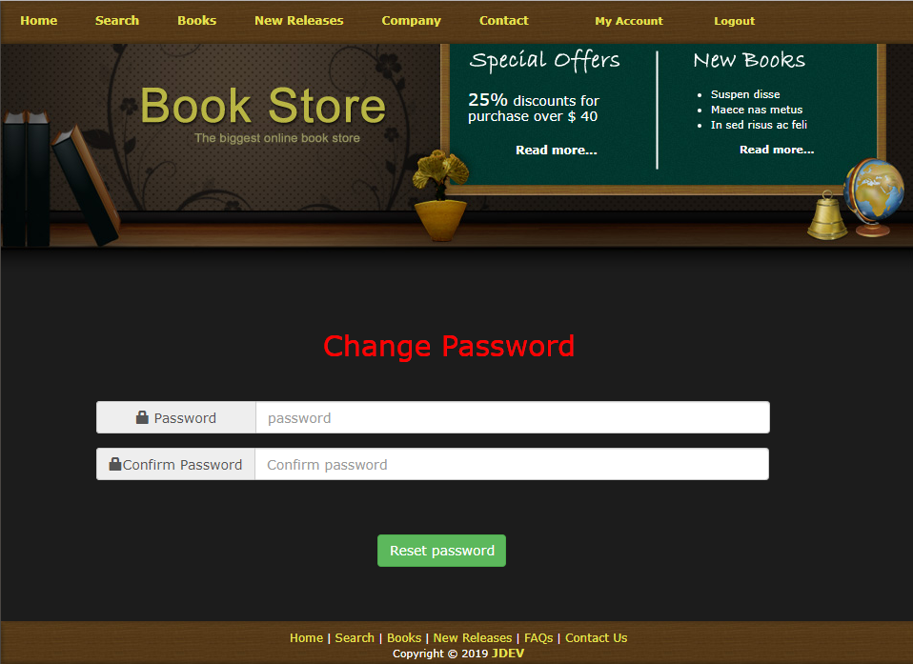
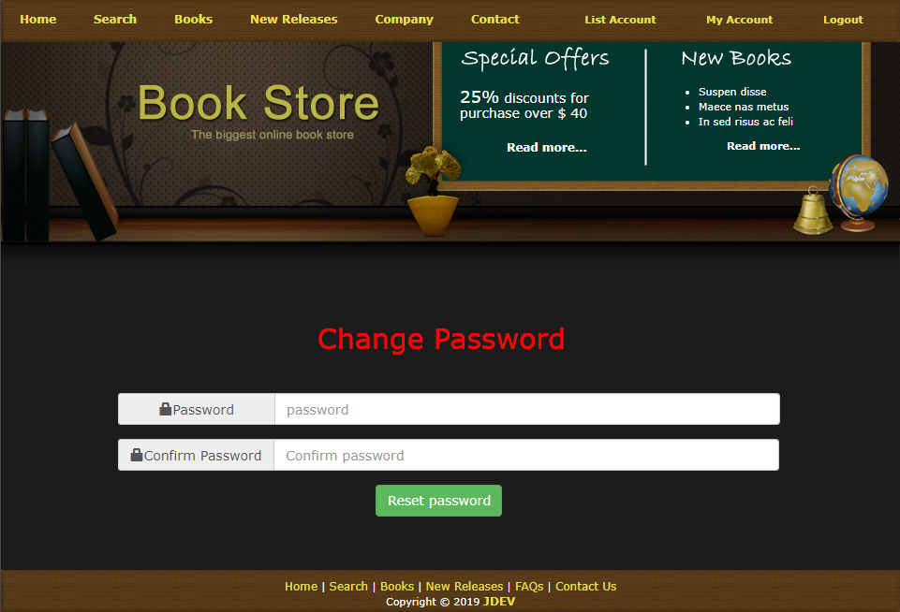
3. FUNCTION LIST
3.1 USER MANAGEMENT
CHANGE PASSWORD USER
CHANGE PASSWORD ADMIN

Slide 17

3. FUNCTION LIST
3.1 USER MANAGEMENT
INDEX ADMIN

Slide 18
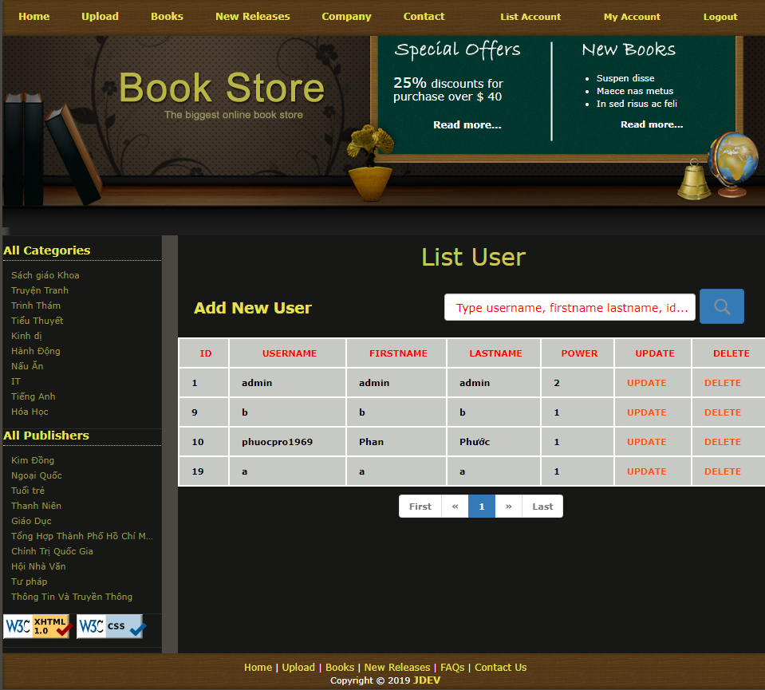
3. FUNCTION LIST
3.1 USER MANAGEMENT
LIST USERS

Slide 19
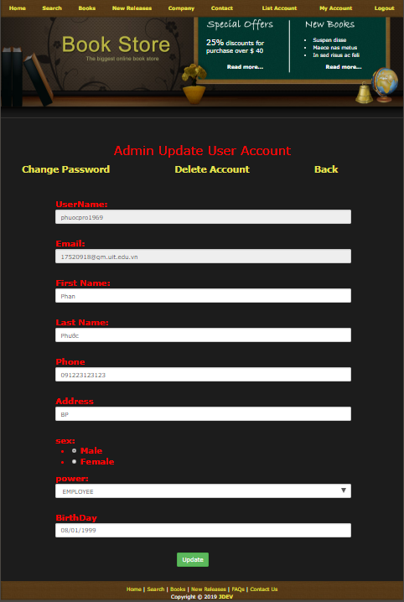
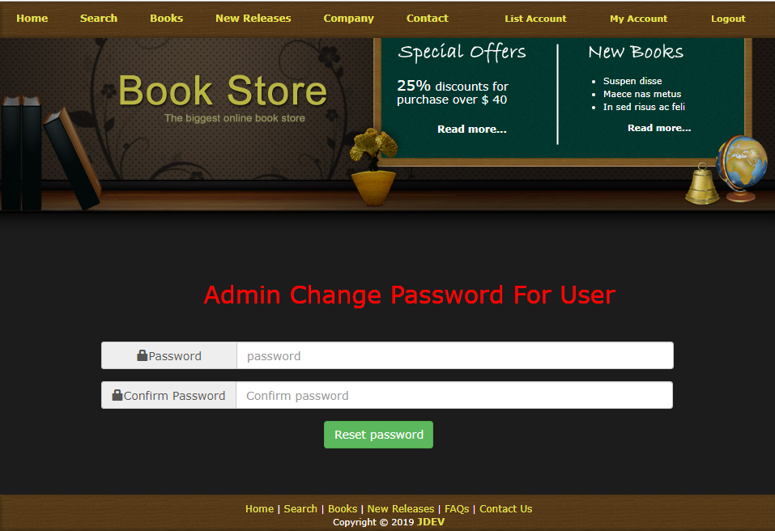
3. FUNCTION LIST
3.1 USER MANAGEMENT
ADMIN EDIT USER
CHANGE PASSWORD USER

Slide 20
3. FUNCTION LIST
3.1 USER MANAGEMENT
LIST USERS

Slide 21
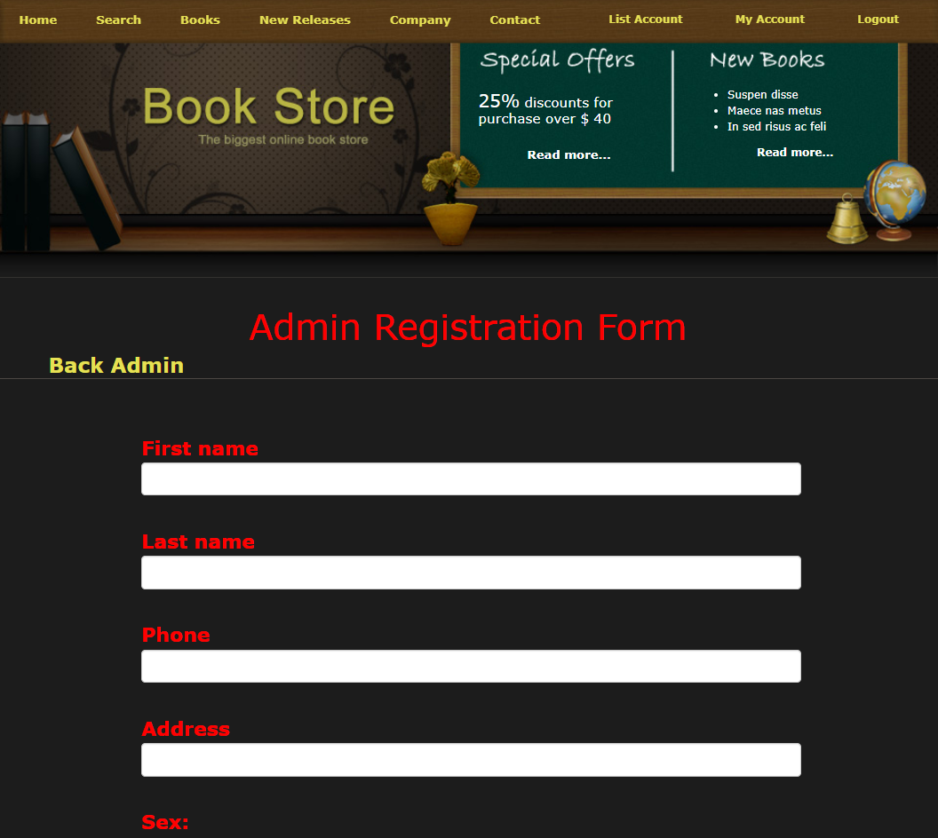
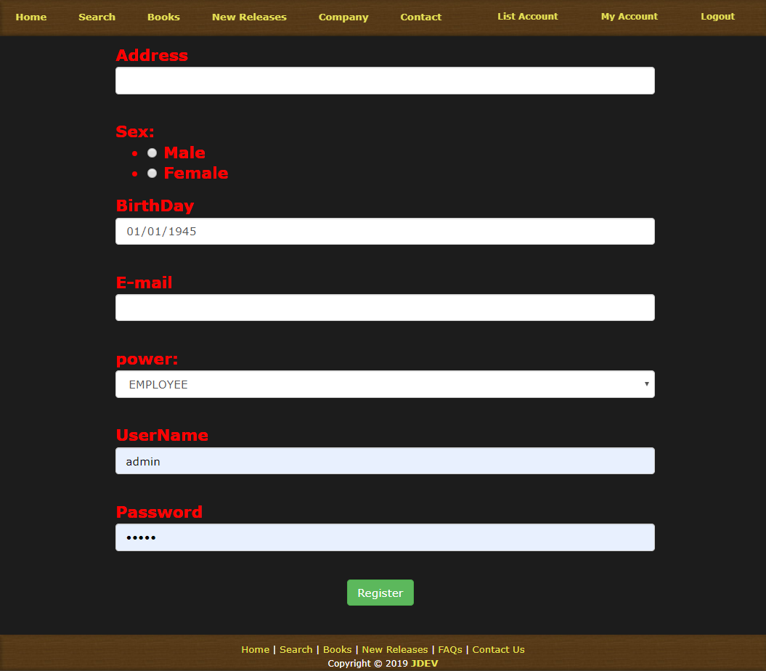
3. FUNCTION LIST
3.1 USER MANAGEMENT
ADMIN REGISTER USER

Slide 22
3. FUNCTION LIST
3.2 PUBLISHINGHOUSE MANAGEMENT
INDEX

Slide 23
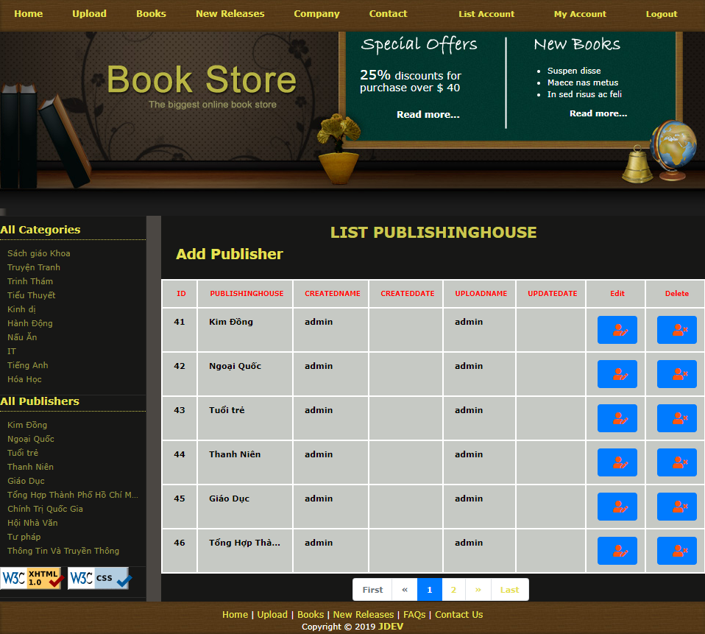
3. FUNCTION LIST
3.2 PUBLISHINGHOUSE MANAGEMENT
LIST PUBLISHING HOUSE

Slide 24
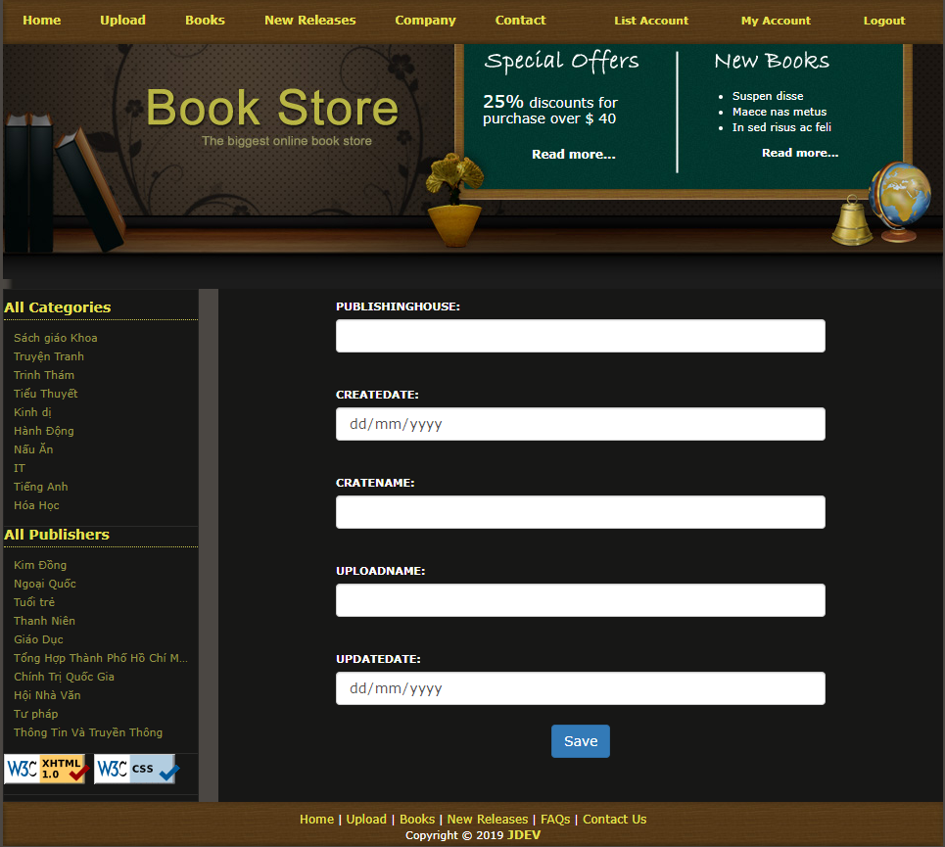
3. FUNCTION LIST
3.2 PUBLISHINGHOUSE MANAGEMENT
ADD PUBLISHING HOUSE

Slide 25
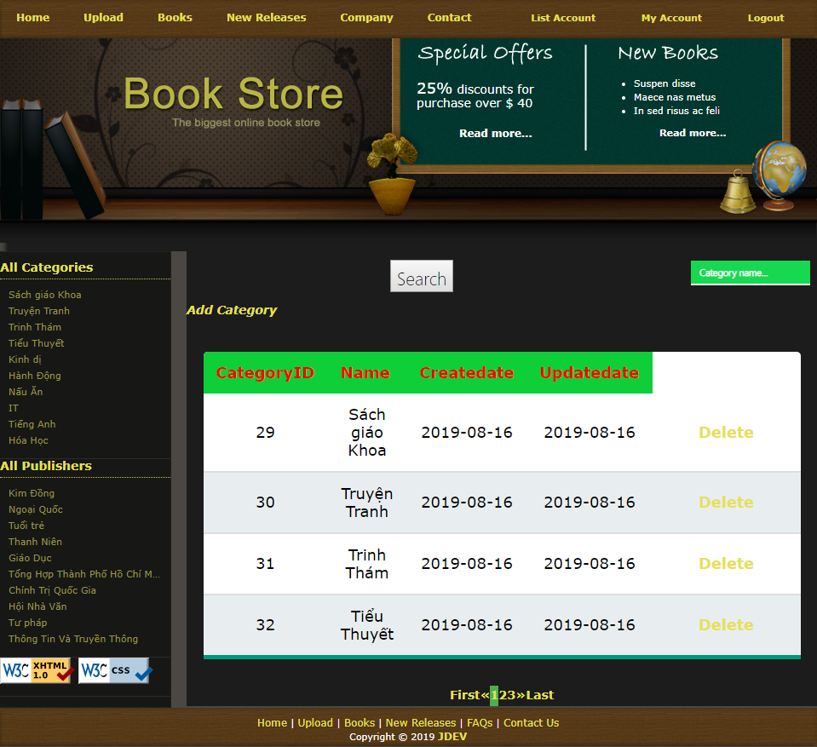
3. FUNCTION LIST
3.3 CATEGORY MANAGEMENT
LIST CATEGORIES

Slide 26
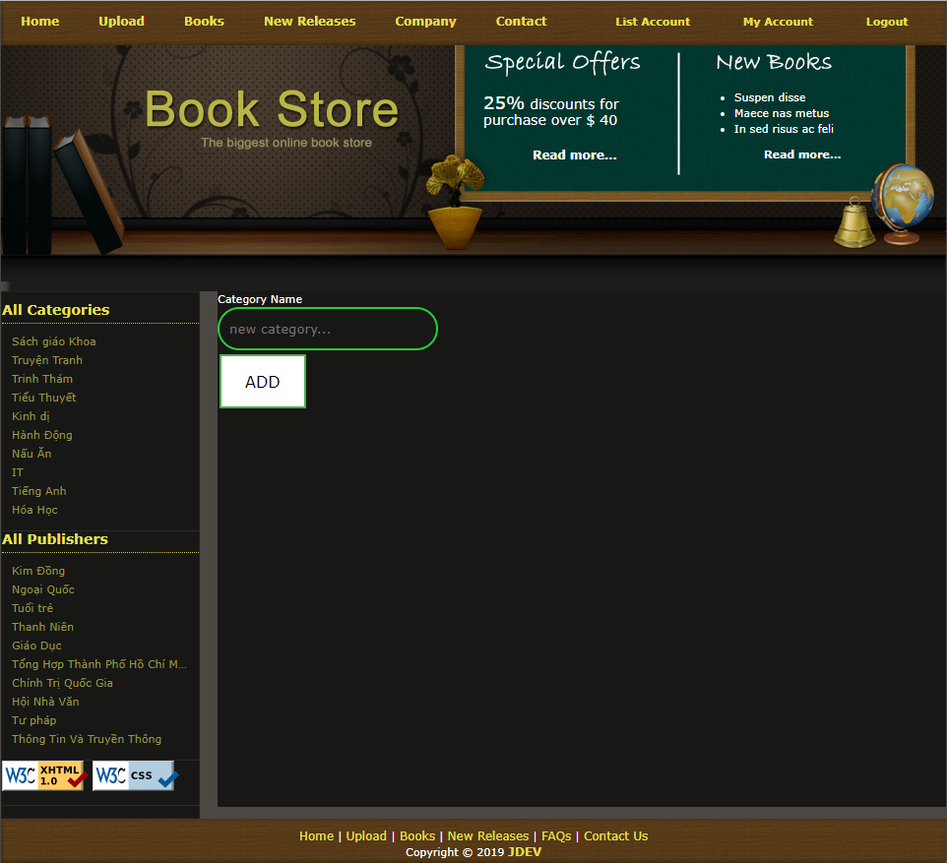
3. FUNCTION LIST
3.3 CATEGORY MANAGEMENT
ADD PUBLISHING HOUSE

Slide 27
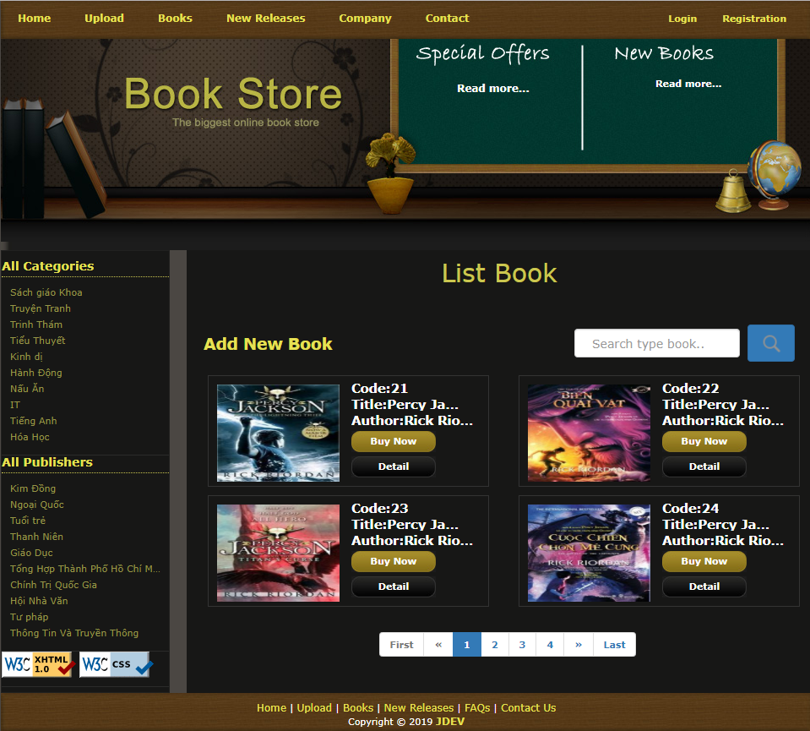
3. FUNCTION LIST
3.4 BOOK MANAGEMENT
LIST BOOKS

Slide 28
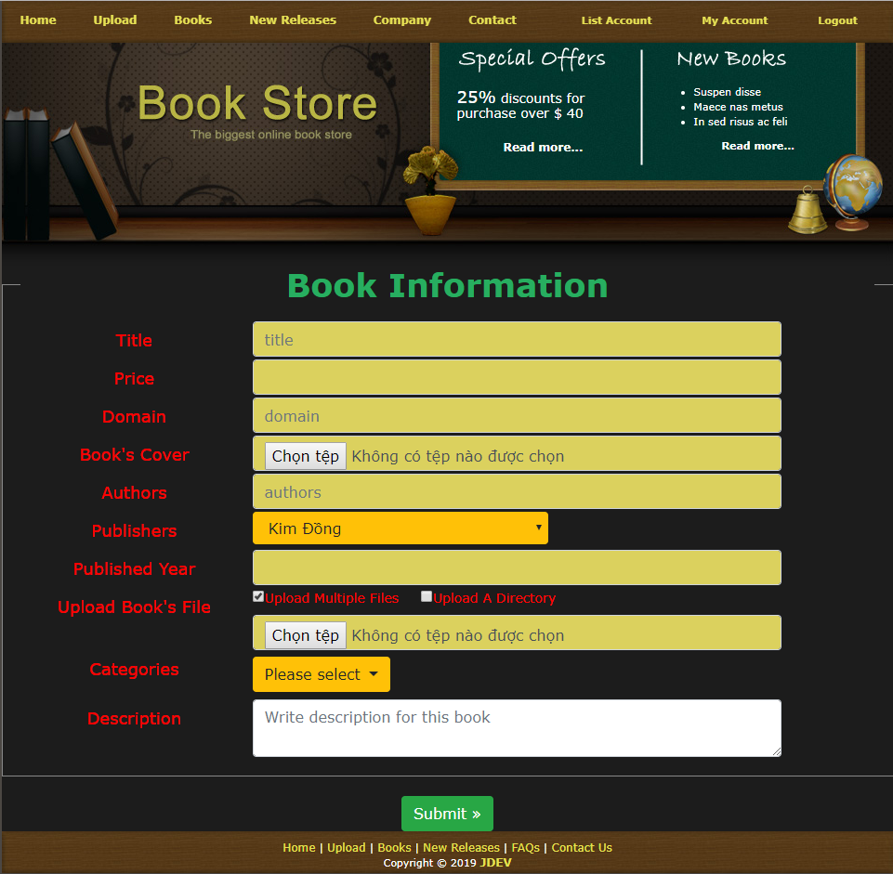
3. FUNCTION LIST
3.4 BOOK MANAGEMENT
ADD BOOK

Slide 29
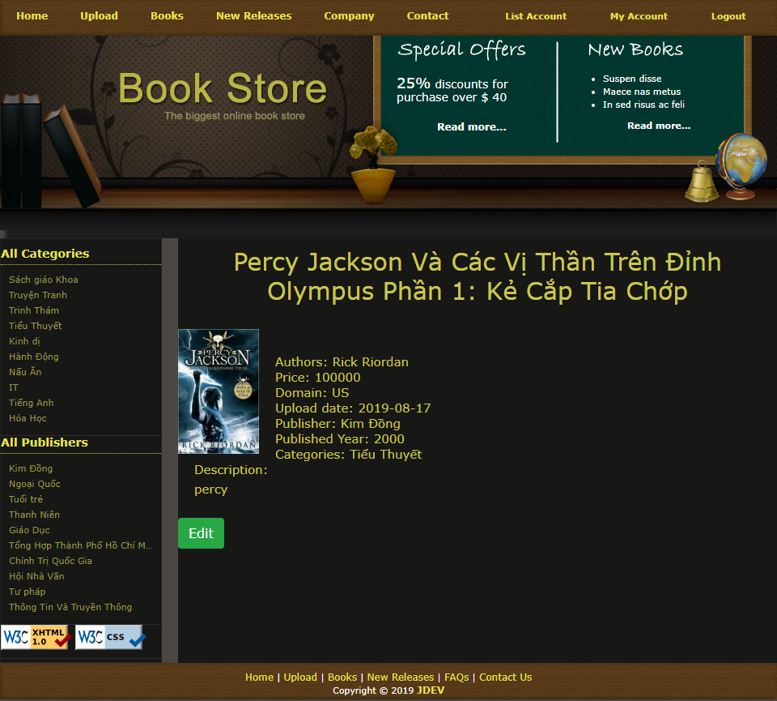
3. FUNCTION LIST
3.4 BOOK MANAGEMENT
INFORMATION BOOK

Slide 30
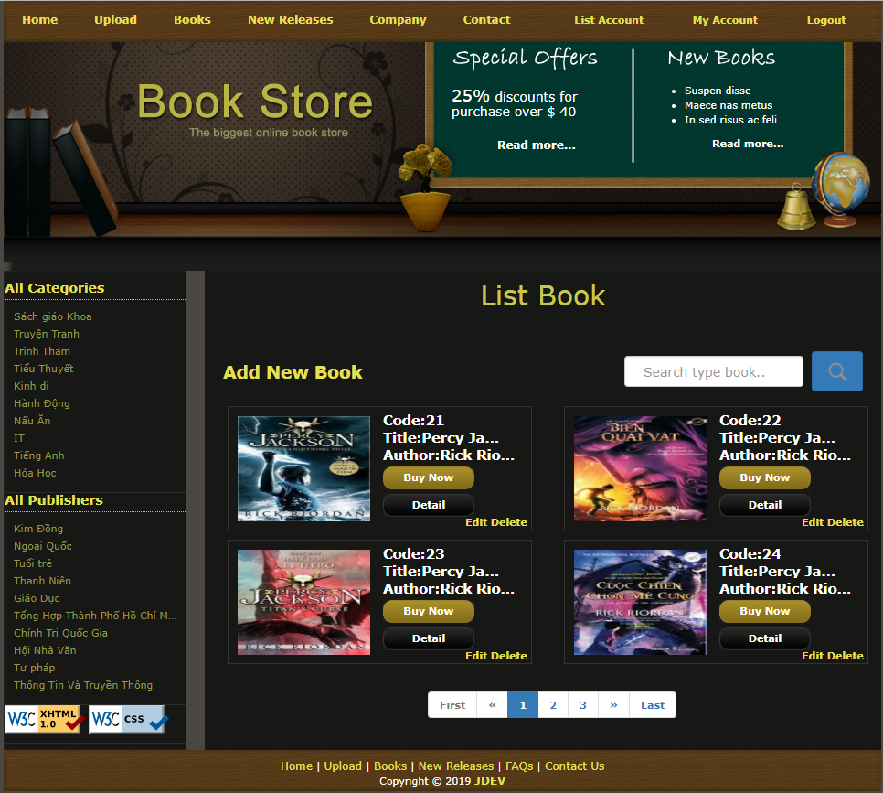
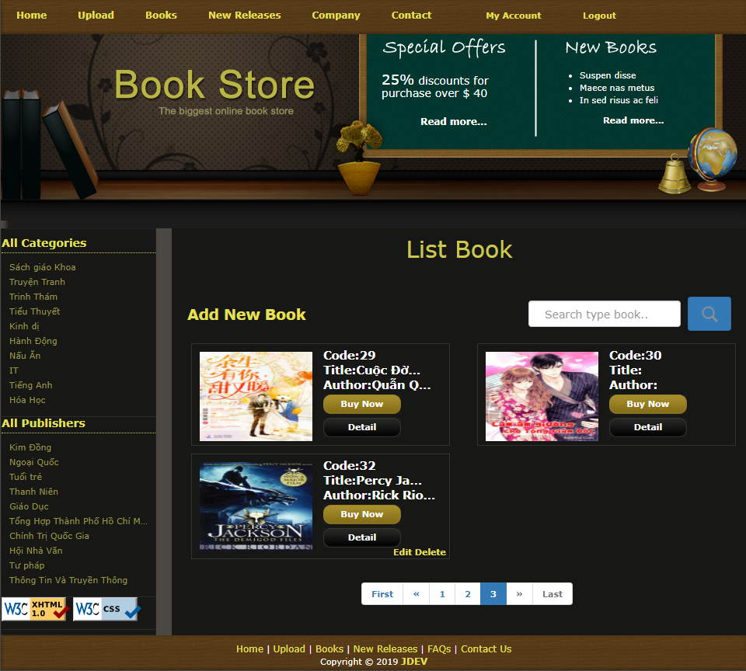
3. FUNCTION LIST
3.4 BOOK MANAGEMENT
LIST BOOKS ADMIN
LIST BOOKS USER

Slide 31

3. FUNCTION LIST
3.4 BOOK MANAGEMENT
EDIT BOOKS

Slide 32


